Slide 1

CIS 467 :Data Mining
Department of Information Systems
Faculty of Information Technology and Computer Sciences
Yarmouk University – Jordan
© Qasem Al-Radaideh
http://faculty.yu.edu.jo/qradaideh/
Notes:
1

Slide 2
Topic 3: Mining Frequent Patterns, Association and Correlations
Main Source: J. Han Book
Data Mining: Concepts and Techniques (3nd ed.)
(Chapter 6)
Notes:
2

Slide 3
Main Outline
Basic Concepts and a Road Map
Frequent Item set Mining Methods
The Apriori Algorithm
Generating Association Rules
Illustration with full example
Using WEKA software for Association Rules Mining
Methods for Enhancing Association Rule Mining

Slide 4
Data Mining Models and Tasks
Reminder
Data Mining
Predictive
Descriptive
Classification
Regression
Clustering
Association Rules
Prediction
Time Series Analysis
Sequence Discovery
Summarisation
4

Slide 5
Mining Frequent Patterns
Frequent patterns are patterns (such as itemsets, subsequences, or
substructures) that appear in a data set frequently.
For example, a set of items, such as milk and bread, that appear frequently together in a transaction data set is a frequent itemset.
A subsequence, such as buying first a PC, then a digital camera, and then a memory card, if it occurs frequently in a shopping history database, is a (frequent) sequential pattern.
A substructure can refer to different structural forms, such as subgraphs, subtrees, or sublattices, which may be combined with itemsets or subsequences. If a substructure occurs frequently, it is called a (frequent) structured pattern.
Finding such frequent patterns plays an essential role in mining associations, correlations, and many other interesting relationships among data.
Moreover, it helps in data classification, clustering, and other data mining tasks as well.
Thus, frequent pattern mining has become an important data mining task and a focused theme in data mining research.

Slide 6
Mining Frequent Patterns (Basic Concepts and a Road Map)
This section introduces the basic concepts of frequent pattern mining for the discovery of interesting associations and correlations between itemsets in transactional and relational databases.

Slide 7
Market Basket Analysis: A Motivating Example
Frequent itemset mining leads to the discovery of associations and correlations among items in large transactional or relational data sets.
With massive amounts of data continuously being collected and stored, many industries are becoming interested in mining such patterns from their databases.
The discovery of interesting correlation relationships among huge amounts of business transaction records can help in many business decision-making processes such as :
catalog design,
cross-marketing, and
Customer shopping behavior analysis.

Slide 8
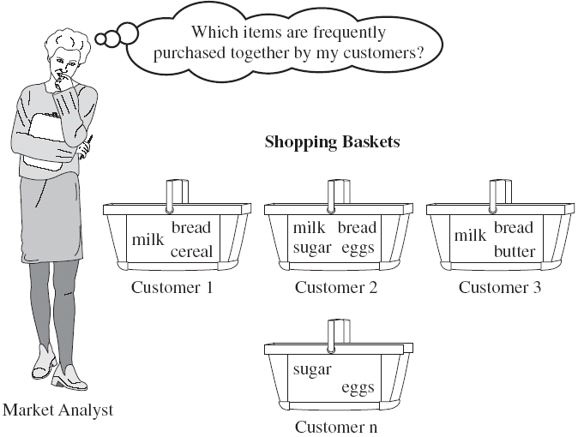
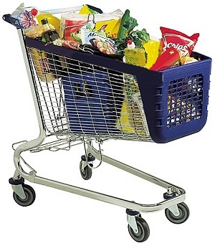
Market Basket Analysis: A Motivating Example
- A typical example of frequent itemset mining is market basket analysis. This process analyzes customer buying habits by finding associations between the different items that customers place in their “shopping baskets” (Figure 6.1).
- The discovery of such associations can help retailers develop marketing strategies by gaining insight into which items are frequently purchased together by customers.
8

Slide 9
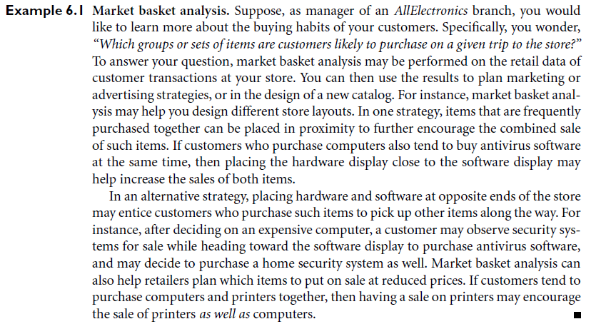
Market Basket Analysis: A Motivating Example

Slide 10
Definitions: Frequent Itemset
Item: attribute=value pair or simply value
Example {Bread}
Itemset
A collection of one or more items
Example: {Milk, Bread, Diaper}
k-itemset
An itemset that contains k items
Support count (σ) (Absolute Support)
Frequency of occurrence of an itemset
E.g. σ ({Milk, Bread, Diaper}) = 2
Support (s) (Relative Support)
Fraction of transactions that contain an itemset
E.g. S ({Milk, Bread, Diaper}) = 2/5
Frequent Itemset
An itemset whose support is greater than or equal (>=) to a minsup threshold
10

Slide 11
Association Rules Mining
Association rules are if/then statements that help uncover relationships between seemingly unrelated data in a relational or transactional database or other information repository.
An example of an association rule would be :
"If a customer buys a dozen eggs,
he is 80% likely to also purchase milk.“
An association rule has two parts:
an antecedent (if) and a consequent (then).
An antecedent is an item found in the data. A
consequent is an item that is found in combination with the antecedent.
Association rules are created by analyzing data for frequent if/then patterns and using the criteria support and confidence to identify the most important relationships.
Support: is an indication of how frequently the items appear in the database.
Confidence : indicates the number of times the if/then statements have been found to be true.

Slide 12
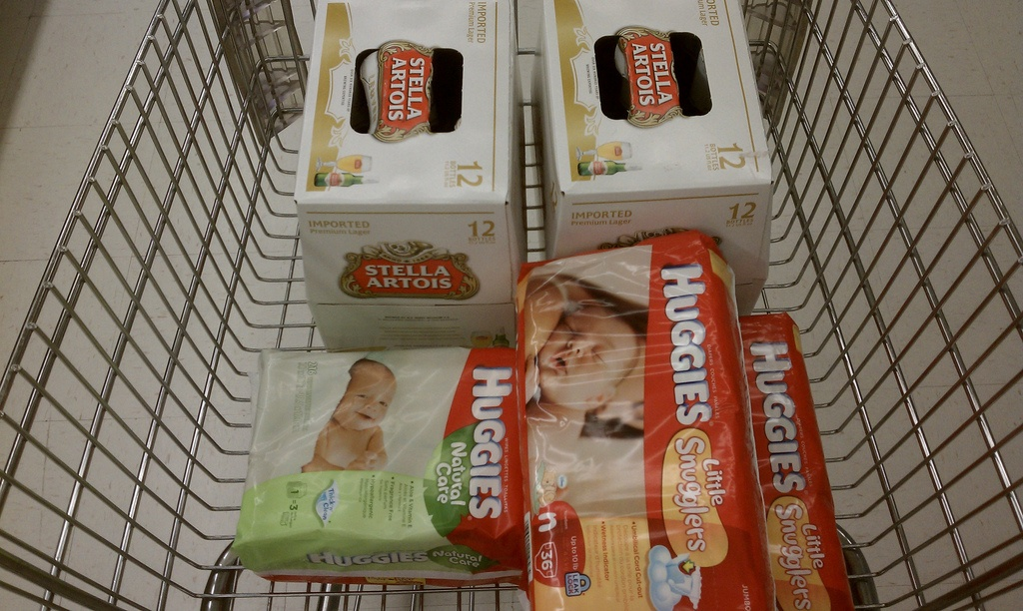
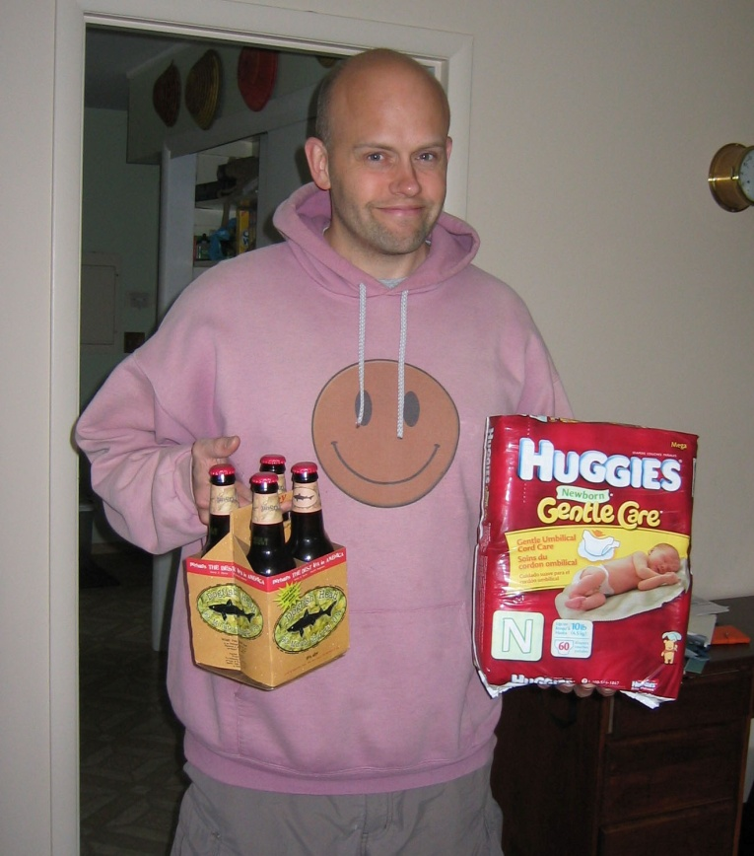
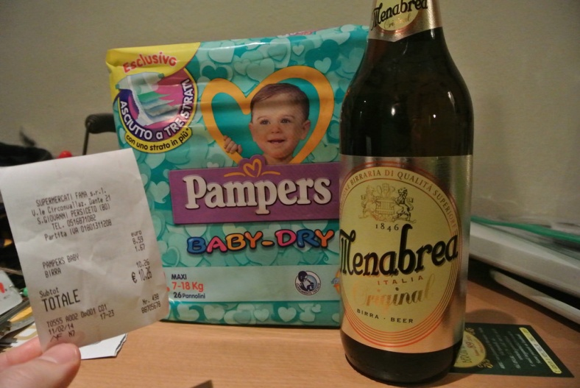
Break: The Story of Diaper and Beer
One of the most popular Association rule is:
Diaper → Beer
http://max.magaret.com/?m=20080601
http://cliintel.com/diapers-beer-and-data-in-retail/

Slide 13
The Apriori Algorithm: Finding Frequent Itemsets Using Candidate Generation
First proposed by Agrawal, Imielinski, and Swami [AIS93] in the context of frequent itemsets and association rule mining
Motivation: Finding inherent regularities in data
What products were often purchased together?— Drink and diapers?!
What are the subsequent purchases after buying a PC?
What kinds of DNA are sensitive to this new drug?
Can we automatically classify web documents?
Applications
Basket data analysis, cross-marketing, catalog design, sale campaign analysis, Web log (click stream) analysis, and DNA sequence analysis.

Slide 14
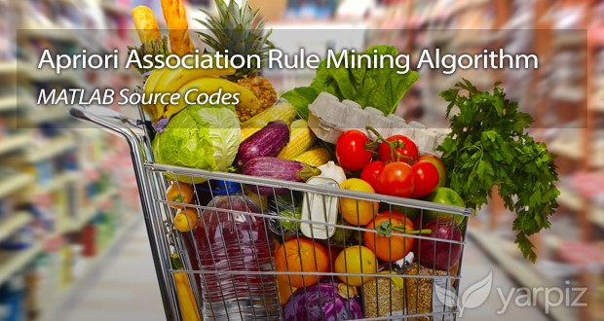
Examples of Association Rules
Rule form: “Body → Ηead [support, confidence]”.
Types:
(1) Single Dimensional Association Rule
Examples:
Buys (x, “diapers”) → buys (x, “drink”) [0.5%, 60%]
98% of people who purchased items A and B also purchased item C
(2) Multi Dimensional Association Rule
Example:
Major (x, “CS”) ^ takes (x, “DB”) → grade(x, “A”) [1%, 75%]
14

Slide 15
Definition: Association Rule
Association Rule
An implication expression of the form X → Y, where X and Y are itemsets
Example: {Milk, Diaper} → {Drink}
Rule Evaluation Metrics
Support (s)
Fraction of transactions that contain both X and Y
Confidence (c)
Measures how often items in Y appear in transactions that contain X
Example:

Slide 16
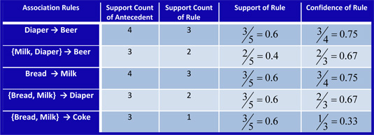
Examples

Slide 17
Mining Association Rules— Another Example
Examples:
A) Find Support and Confidence of the rule (A ⇒ C).
1) Support (A ⇒ C) = support({A & C}) = 50%
2) Confidence (A ⇒ C) = support({A & C})/support({A})
= 66.6%
Then A ⇒ C (50%, 66.6%) is called strong rule.
B) Find Support and Confidence of the rule (C⇒ A). [In class]
1) Support (C ⇒ A) = ??
2) Confidence (C ⇒ A) = ??
Then C ⇒ A (??%, ?? %) is called strong/weak rule.
Assume:
- Min. support = 50%
- Min. confidence = 50%

Slide 18
Mining Association Rules
(The Process)

Slide 19
Association Rule Mining: Formal Definition
Input: Given a set of records each of which contain some number of items from a given collection and support and confidence thresholds;
Output: Produce dependency rules which will predict occurrence of an item based on occurrences of other items.
Input
Output
Examples of Rules Discovered:
{Milk} --> {Coke}
{Diaper, Milk} --> {Water}
- Support and Confidence thresholds

Slide 20
Mining Association Rules
Generally it is a Two-step approach:
Frequent Itemset (F) Generation
Generate all itemsets whose support ≥ minsup
Association Rules (Ars) Generation
Once the frequent itemsets from transactions in a database D have been found, it is straightforward to generate strong association rules from the frequent itemsets (where strong association rules satisfy both minimum support and minimum confidence).
Note:
Finding Frequent itemset F is the most computationally expensive part, once we have the frequent sets generating ARs is straight forward.

Slide 21
Frequent Itemset Generation: The Problem (1)
A major challenge in mining frequent itemsets from a large data set is the fact that such mining often generates a huge number of itemsets satisfying the minimum support (min sup) threshold, especially when min sup is set low. This is because if an itemset is frequent, each of its subsets is frequent as well
In this Lattice, number of items = 5
(A, B, C, D, E)
In general:
Given d items, there are 2^{d} possible candidate itemsets

Slide 22
Frequent Itemset Generation: The Problem (2)
Brute-force approach:
Each itemset in the lattice is a candidate frequent itemset
Count the support of each candidate by scanning the database
Match each transaction against every candidate
Complexity ~ O(NMw) => Expensive since M = 2^{d} !!!

Slide 23
Mining Frequent Itemsets Using Candidate Generation The Apriori Algorithm
Apriori is a seminal algorithm proposed by R. Agrawal and R. Srikant in 1994 for mining frequent itemsets for Boolean association rules.
The name of the algorithm is based on the fact that the algorithm uses prior knowledge of frequent itemset properties.
Apriori pruning principle: If there is any itemset which is infrequent, its superset should not be generated/tested!
Apriori employs an iterative approach known as a level-wise search, where k-itemsets are used to explore (k+1) itemsets.

Slide 24
The Apriori Algorithm
Motivation: Finding inherent regularities in data
What products were often purchased together?— Drink and diapers?!
What are the subsequent purchases after buying a PC?
What kinds of DNA are sensitive to this new drug?
Can we automatically classify web documents?
Applications
Basket data analysis, cross-marketing, catalog design, sale campaign analysis, Web log (click stream) analysis, and DNA sequence analysis.

Slide 25
Illustrating Apriori Principle
Found to be Infrequent
Pruned supersets

Slide 26
The Apriori Algorithm in Simple form
The Steps of the Apriori Method:
Let k=1
Generate frequent itemsets of length 1 (1-itemset)
Repeat until no new frequent itemsets are identified
Generate length (k+1) candidate itemsets from length k frequent itemsets
Prune candidate itemsets containing subsets of length k that are infrequent
Count the support of each candidate by scanning the DB
Eliminate candidates that are infrequent, leaving only those that are frequent
Terminate when no frequent or candidate set can be generated

Slide 27
The Apriori Algorithm: Example (Section 6.2.1)
TID | List of Items
T100 | I1, I2, I5
T200 | I2, I4
T300 | I2, I3
T400 | I1, I2, I4
T500 | I1, I3
T600 | I2, I3
T700 | I1, I3
T800 | I1, I2 ,I3, I5
T900 | I1, I2, I3
Consider a database, D , consisting of 9 transactions.
Suppose min. support count required is 2 (i.e. min_sup = 2/9 = 22 % )
Let minimum confidence required is 70%.
We have to first find out the frequent itemset using Apriori algorithm.
Then, Association rules will be generated using min. support & min. confidence.
Note: Play around this dataset before you start the apriori.
For example:
Find the counts for some itemsets and the support for them.
Find the confidence for some association rules (2,3 → 5).

Slide 28
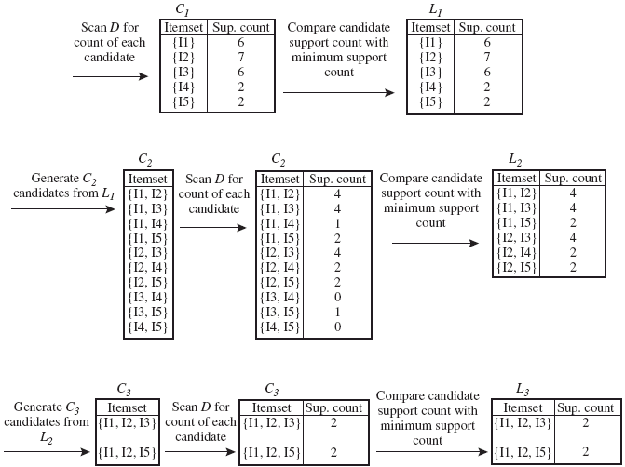
Solution:
TID | List of Items
T100 | I1, I2, I5
T200 | I2, I4
T300 | I2, I3
T400 | I1, I2, I4
T500 | I1, I3
T600 | I2, I3
T700 | I1, I3
T800 | I1, I2 ,I3, I5
T900 | I1, I2, I3
Note: See Next slides for more details about each step in this example.

Slide 29
Step 1: Generating 1-itemset Frequent Pattern
Itemset | Sup.Count
{I1} | 6
{I2} | 7
{I3} | 6
{I4} | 2
{I5} | 2
Compare candidate support count with minimum support count
Itemset | Sup.Count
{I1} | 6
{I2} | 7
{I3} | 6
{I4} | 2
{I5} | 2
Scan D for count of each candidate
C₁
L₁
In the first iteration of the algorithm, each item is a member of the set of candidate.
The set of frequent 1-itemsets, L₁ , consists of the candidate 1-itemsets satisfying minimum support.

Slide 30
Step 2: Generating 2-itemset Frequent Pattern
Itemset
{I1, I2}
{I1, I3}
{I1, I4}
{I1, I5}
{I2, I3}
{I2, I4}
{I2, I5}
{I3, I4}
{I3, I5}
{I4, I5}
Itemset | Sup. Count
{I1, I2} | 4
{I1, I3} | 4
{I1, I4} | 1
{I1, I5} | 2
{I2, I3} | 4
{I2, I4} | 2
{I2, I5} | 2
{I3, I4} | 0
{I3, I5} | 1
{I4, I5} | 0
Itemset | Sup Count
{I1, I2} | 4
{I1, I3} | 4
{I1, I5} | 2
{I2, I3} | 4
{I2, I4} | 2
{I2, I5} | 2
Generate C₂ candidates from L₁
Compare candidate support count with minimum support count
Scan D for count of each candidate
L₂
C₂
C₂

Slide 31
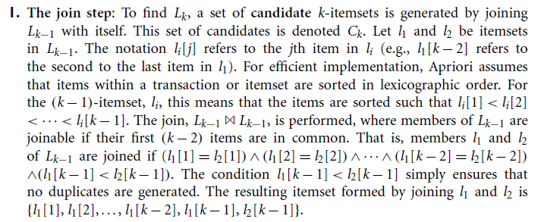

Slide 32
Step 2: Generating 2-itemset Frequent Pattern [Cont.]
To discover the set of frequent 2-itemsets, L₂ , the algorithm uses L₁ Join L₁ to generate a candidate set of 2-itemsets, C₂.
Next, the transactions in D are scanned and the support count for each candidate itemset in C₂ is accumulated (as shown in the middle table).
The set of frequent 2-itemsets, L₂ , is then determined, consisting of those candidate 2-itemsets in C₂ having minimum support.
Note: We haven’t used Apriori Property yet.

Slide 33
Step 3: Generating 3-itemset Frequent Pattern
Compare candidate support count with min support count
Scan D for count of each candidate
Scan D for count of each candidate
Itemset | Sup. Count
{I1, I2, I3} | 2
{I1, I2, I5} | 2
Itemset | Sup Count
{I1, I2, I3} | 2
{I1, I2, I5} | 2
Itemset
{I1, I2, I3}
{I1, I2, I5}
C₃
C₃
L₃
The generation of the set of candidate 3-itemsets, C₃ , involves use of the Apriori Property.
In order to find C₃, we compute L₂ Join L₂.
C₃ = L2 Join L2 = {{I1, I2, I3}, {I1, I2, I5}, {I1, I3, I5}, {I2, I3, I4}, {I2, I3, I5}, {I2, I4, I5}}.
Now, Join step is complete and Prune step will be used to reduce the size of C₃. Prune step helps to avoid heavy computation due to large C_{k}.

Slide 34
Step 3: Generating 3-itemset Frequent Pattern [Cont.]
Based on the Apriori property that all subsets of a frequent itemset must also be frequent, we can determine that four latter candidates cannot possibly be frequent. How ?
For example , lets take {I1, I2, I3}. The 2-item subsets of it are {I1, I2}, {I1, I3} & {I2, I3}. Since all 2-item subsets of {I1, I2, I3} are members of L₂, We will keep {I1, I2, I3} in C₃.
Lets take another example of {I2, I3, I5} which shows how the pruning is performed. The 2-item subsets are {I2, I3}, {I2, I5} & {I3,I5}.
BUT, {I3, I5} is not a member of L₂ and hence it is not frequent violating Apriori Property. Thus We will have to remove {I2, I3, I5} from C₃.
Therefore, C₃ = {{I1, I2, I3}, {I1, I2, I5}} after checking for all members of result of Join operation for Pruning.
Now, the transactions in D are scanned in order to determine L₃, consisting of those candidates 3-itemsets in C₃ having minimum support.

Slide 35
Step 4: Generating 4-itemset Frequent Pattern
The algorithm uses L₃ Join L₃ to generate a candidate set of 4-itemsets, C₄. Although the join results in {{I1, I2, I3, I5}}, this itemset is pruned since its subset {{I2, I3, I5}} is not frequent.
Thus, C₄ = φ , and algorithm terminates, having found all of the frequent items. This completes our Apriori Algorithm.
What’s Next ?
These frequent itemsets will be used to generate strong association rules ( where strong association rules satisfy both minimum support & minimum confidence).

Slide 36
Second Step: Rule Generation
The Principle.
This is called
a Lattice of rules
Low Confidence Rule
Pruned Rules

Slide 37
From Frequent Itemsets to Association Rules
Q: Given frequent set {A,B,E}, what are possible association rules?
A => B, E
A, B => E
A, E => B
B => A, E
B, E => A
E => A, B
__ => A,B,E (empty rule), or true => A,B,E

Slide 38
Association Rules Examples
Q1: Given frequent set {A,B,E}, what association rules have minsup = 2 and minconf= 50% ?
A, B => E : conf=2/4 = 50%
Q2: Given frequent set {A,B,E}, what association rules have minsup = 2 and minconf= 50% ?
A, B => E : conf=2/4 = 50%
A, E => B : conf=2/2 = 100%
B, E => A : conf=2/2 = 100%
E => A, B : conf=2/2 = 100%
Don’t qualify
A =>B, E : conf=2/6 =33%< 50%
B => A, E : conf=2/7 = 28% < 50%
__ => A,B,E : conf: 2/9 = 22% < 50%

Slide 39
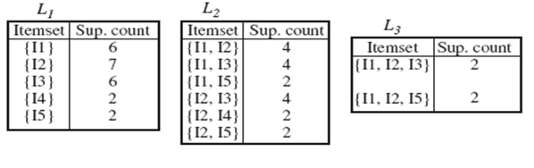
Generating Association Rules from Frequent Itemsets
Back To Example:
L = { L1, L2, L3}
So We had L = {{I1}, {I2}, {I3}, {I4}, {I5}, {I1,I2}, {I1,I3}, {I1,I5}, {I2,I3}, {I2,I4}, {I2,I5}, {I1,I2,I3}, {I1,I2,I5}}.
Lets take l = {I1, I2, I5}.
Its all nonempty subsets are {I1,I2}, {I1,I5}, {I2,I5}, {I1}, {I2}, {I5}.
Procedure:
For each frequent itemset “l”, generate all nonempty subsets of l.
For every nonempty subset s of l, output the rule “s → (l-s)” if
support_count(l) / support_count(s) >= min_conf where min_conf is minimum confidence threshold.

Slide 40
Generating Association Rules from Frequent Itemsets [Cont.]
Let minimum confidence threshold is , say 70%.
The resulting association rules are shown below, each listed with its confidence.
R1: I1 ^ I2 → I5
Confidence = sc{I1,I2,I5}/sc{I1,I2} = 2/4 = 50%
R1 is Rejected.
R2: I1 ^ I5 → I2
Confidence = sc{I1,I2,I5}/sc{I1,I5} = 2/2 = 100%
R2 is Selected.
R3: I2 ^ I5 → I1
Confidence = sc{I1,I2,I5}/sc{I2,I5} = 2/2 = 100%
R3 is Selected.

Slide 41
Generating Association Rules from Frequent Itemsets [Cont.]
R4: I1 → I2 ^ I5
Confidence = sc{I1,I2,I5}/sc{I1} = 2/6 = 33%
R4 is Rejected.
R5: I2 → I1 ^ I5
Confidence = sc{I1,I2,I5}/{I2} = 2/7 = 29%
R5 is Rejected.
R6: I5 → I1 ^ I2
Confidence = sc{I1,I2,I5}/ {I5} = 2/2 = 100%
R6 is Selected.
In this way, We have found three strong association rules.
Association rules with minimum support and count are sometimes called “strong” rules

Slide 42
In class Exercise
Do same for {1,2,3}

Slide 43
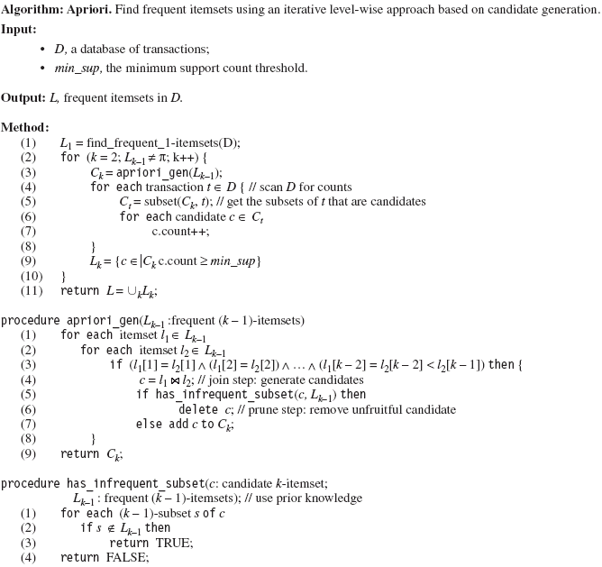
Fig 5.4 : The Apriori Algorithm

Slide 44
Exercise / Homework
Given the following :
- Transactional dataset (D)
- Minimum Support = 2 (20%)
- Minimum Confidence = 70%
Use the Apriori algorithm to Find:
1) The set of frequent courses that are registered together.
2) The set of strong association rules.
St-TID | List of Courses
1 | CIS227, CIS240, CIS260
2 | CIS240, CIS256
3 | CIS240, CIS281
4 | CIS240, CIS256, CIS260
5 | CIS260, CIS281
6 | CIS240, CIS281
7 | CIS260, CIS281
8 | CIS227, CIS240, CIS260, CIS281
9 | CIS240, CIS260, CIS281
10 | CIS256, CIS260, CIS281

Slide 45
Exercise / Homework
Given the following :
- Transactional dataset (D)
- Minimum Support = 50%
- Minimum Confidence = 80%
Use the Apriori algorithm to Find:
1) The set of frequent courses that are registered together.
2) The set of strong association rules.
P-TID | List of Medicines
1 | Penamox, Apisal, Loratan, Scopinal, Flexin
2 | Panadol, Penamox, Loratan, Scopinal
3 | Panadol, Apisal, Loratan, Scopinal
4 | Penamox, Scopinal, Flexin
5 | Panadol, Penamox, Loratan, Scopinal
6 | Penamox, Scopinal, Flexin

Slide 46
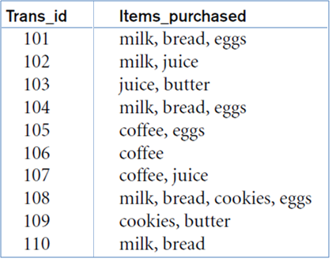
Exercise / Homework
Given the following :
- Transactional dataset (D)
- Minimum Support = 40%
- Minimum Confidence = 95%
Use the Apriori algorithm to Find:
1) The set of frequent courses that are registered together.
2) The set of strong association rules.

Slide 47
You may need Dataset Transformations (preprocessing)
Example
Original Dataset
Converted Dataset
Binary Dataset
ITEMS:
A = milk, B= bread,
C= cereal, D= sugar,
E= eggs
See Chapter 2

Slide 48
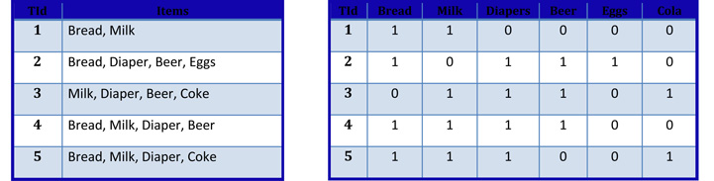
Example: Binary Format

Slide 49
Other Applications for Association Rules and Frequent Itemsets
In addition to the marketing application, the same sort of question has the following uses:
1. Baskets = documents; items = words. Words appearing frequently together in documents may represent phrases or linked concepts. Can be used for intelligence gathering.
2. Baskets = sentences, items = documents. Two documents with many of the same sentences could represent plagiarism or mirror sites on the Web.
A text document data set. Each document is treated as a “bag” of keywords
Documents | Terms
doc1: | Student, Teach, School
doc2: | Student, School
doc3: | Teach, School, City, Game
doc4: | Baseball, Basketball
doc5: | Basketball, Player, Spectator
doc6: | Baseball, Coach, Game, Team
doc7: | Basketball, Team, City, Game
49

Slide 50
Challenges of Frequent Pattern Mining

Slide 51
Challenges of Frequent Pattern Mining
Challenges
Multiple scans of transaction database
Huge number of candidates
Tedious workload of support counting for candidates
Improving Apriori: general ideas
Reduce passes of transaction database scans
Shrink number of candidates
Facilitate support counting of candidates

Slide 52
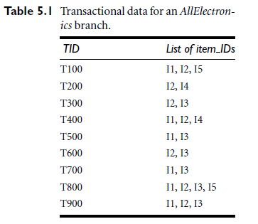
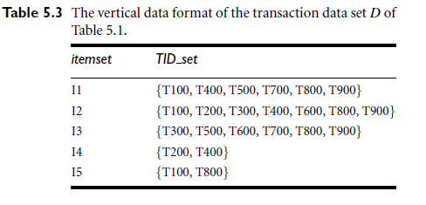
Alternative Methods for Frequent Itemset Generation
Representation of Database
Horizontal vs Vertical data layout

Slide 53
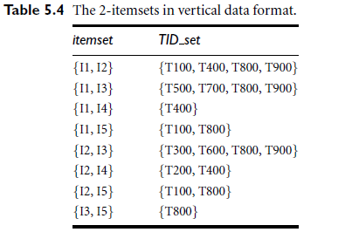
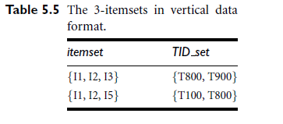
Mining frequent itemsets using vertical data format
Example: Consider the horizontal data format of the transaction database, D, of Table 5.1 in Example 5.3. This can be transformed into the vertical data format shown in Table 5.3 by scanning the data set once.
These are the frequent Item Sets.
Note: Assume Min Support = 2

Slide 54

Strong Rules Are Not Necessarily Interesting: An Example
Lift is a simple correlation measure. It measures the “surprisingness” (implication intensity) of a rule, expressed as follows:
Or alternatively: lift (A→B) = conf(A→B)/ supp(B)
A rule is “interesting” if lift is greater than 1.
Example: if conf(A→B)=x and supp(B)=x then lift(A→B)=1. This means that the probability of B occurring with A is no different to B occurring without A, the rule is therefore deemed to be unsurprising.

Slide 55
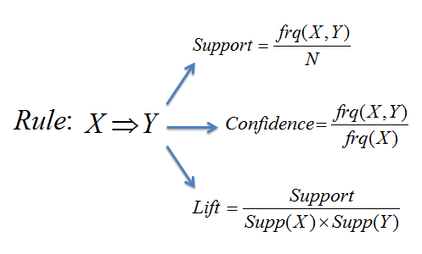
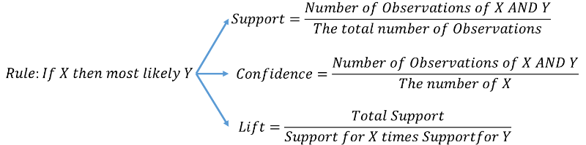
Measures: Summary

Slide 56
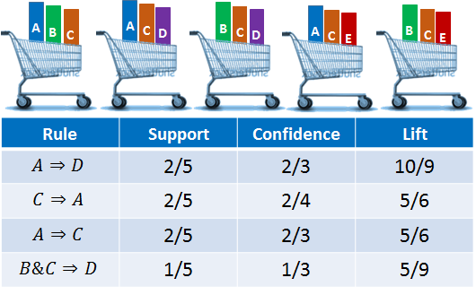
Exercise : Check the correctness of numbers

Slide 57
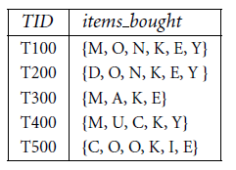
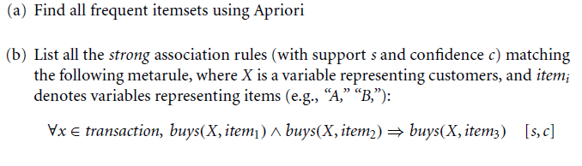
Exercise : From Book
A database D has five transactions. Let
min sup (D) = 60% and
min conf (D) = 80%.

Slide 58
Useful Videos
If you need more assistant to understand the topic:
1) Read the book
2) You can find many resources in Youtupe, in Arabic, English, French, Tamile, Dutch ….
https://www.youtube.com/watch?v=rfpi7-NYYos
https://www.youtube.com/watch?v=JZepOmvB514
https://www.youtube.com/watch?v=Hk1zFOMLTrw
https://www.youtube.com/watch?v=4V7MZH_4RXg

Slide 59
Generating Association Rules using
Any Data Mining tool Kit.

Slide 60
Summary
Association Rule Mining
Finding interesting association or correlation relationships.
Association rules are generated from frequent itemsets.
Frequent itemsets are mined using Apriori algorithm or Frequent-Pattern Growth method.
Apriori property states that all the subsets of frequent itemsets must also be frequent.
Apriori algorithm uses frequent itemsets, join & prune methods and Apriori property to derive strong association rules.
ARM applications
WEKA and ARM

